Slide 1
Limited English Proficiency and the Fair Housing Act
Salomon Chiquiar-Rabinovich
U.S. Department of Housing and Urban Development
Office of Fair Housing and Equal Opportunity

Slide 2
Limited English Proficiency
Census Bureau defines Limited English Proficiency as speaking English “less than very well”
From 1990 to 2010 the LEP population grew by
57% in MA – 348,000 to 547 thousand
80% in the USA – 14 million to 25.2 million
8.8% of MA’s population is LEP,
slightly above national average.
Notes:
Source: http://www.masslegalservices.org/content/mpi-lep-data

Slide 3
Who determines who is an LEP?
The individual with LEP?
Or the HUD recipient?

Slide 4
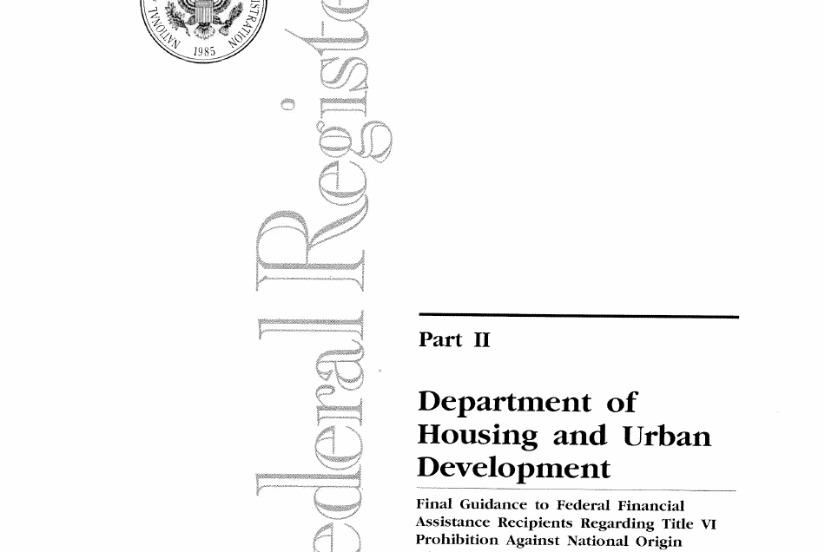
HUD Guidelines Federal Register - Jan 22, 2007

Slide 5
HUD LEP Guidance issued in 2007 pursuant to Executive Order and Title VI applies to recipients of federal financial assistance
Provides 4 factors to assess needs of LEP persons:
The number or proportion of LEP persons served or encountered in the eligible service area
Frequency with which LEP individuals come into contact with program
The nature and importance of the program, activity, or service provided by the program
The resources available to the recipient

Slide 6
Growth of LEP Population

Slide 7
LEP and The Fair Housing Act
Fair Housing Act makes it unlawful to discriminate because of race, color, religion, national origin, sex, disability, and familial status in the sale, rental, or advertising of housing
Discrimination against persons who are Limited English Proficient can violate the Fair Housing Act when LEP is a result of a person’s national origin.

Slide 8
Fair Housing Act Remedies
Injunctive relief
Damages for victim
Policy/practice changes
Relief to protect the public interest
Potentially, identification of additional victims via complaints or victims fund relief

Slide 9
Legal Theories of Discrimination
Direct Evidence
Disparate Treatment
Disparate Impact

Slide 10
Direct Evidence: LEP
Facially discriminatory policy that explicitly treats non-English speakers differently because of their national origin
To violate the Fair Housing Act, direct evidence must reference the national origin of the person, not just the fact that they do not speak English well or at all.
EXAMPLE:
A landlord telling a Mexican family, “I do not rent to Mexicans because they can barely speak English” OR “I don’t rent to people who speak Russian.”

Slide 11
Disparate Treatment: LEP
Housing provider treats LEP persons differently than persons who speak English well, or housing provider treats LEP persons from certain national origins differently than LEP persons from other national origins.

Slide 12
Disparate Treatment: LEP
EXAMPLE:
Applicant who speaks English less well or not at all applies for apartment. Testing shows that only those applicants who are LEP are selected for credit checks or background checks

Slide 13
Disparate Impact: LEP
Facially neutral policy, consistently applied, has a disparate impact on a protected class
Intent to discriminate based on national origin is relevant but not required.
Often arises where housing provider has an “English Only” policy
Even when consistently applied, persons from non-English speaking national origins may be disproportionately affected by these policies, as they comprise the overwhelming majority of persons who cannot speak English well or at all.

Slide 14
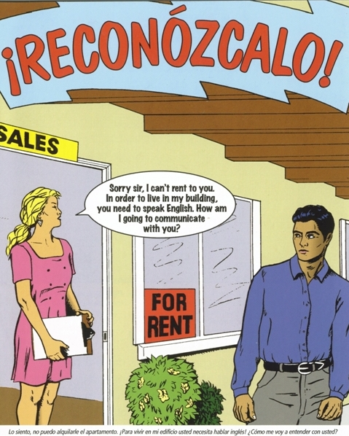
Recognizing Housing Discrimination

Slide 15
Unlawful Discrimination Based on National Origin
Title VIII of the Civil Rights Act of 1968 (The Fair Housing Act) prohibits discrimination in housing on the basis of race, color, religion, sex and/or national origin.

Slide 16
Investigating Disparate Impact Claims
Five steps:
Identify the specific policy or policies that are allegedly discriminatory (“Must speak English”)
Determine whether the policy was consistently applied (if not, see unequal treatment)
Examine the impact of the policy based on national origin using statistics for the particular group (May aggregate groups—e.g. impact in community on Spanish speakers)
If a disparate impact is found, identify the landlord’s reasons for the policy – are they real and supported by a substantial business justification?
If a substantial business justification exists, is there a less discriminatory alternative?

Slide 17
Disparate Impact: LEP
EXAMPLE:
Applicants are told that they must speak and read English to apply. Policy is consistently applied. In area, disproportionate impact is on Russian speakers.
Justification is the need for prompt communication between tenant and landlord in case of emergency
Less discriminatory alternatives might include use of Language Line for communication OR designation of English speaker as intermediary for communication

Slide 18
Title VI LEP Compliance
HUD LEP Guidance issued in 2007 pursuant to Executive Order and Title VI applies to recipients of federal financial assistance
Provides 4 factors to assess needs of LEP persons:
The number or proportion of LEP persons served or encountered in the eligible service area
Frequency with which LEP individuals come into contact with program
The nature and importance of the program, activity, or service provided by the program
The resources available to the recipient

Slide 19
Title VI Investigations/Limited Compliance Reviews
Number or proportion of LEP persons served or encountered by eligible service area
To determine, consider only LEP persons and not all persons from non-English speaking national origins

Slide 20
Title VI Enforcement
Complaint investigations initiated by conversation or letter
Compliance reviews
Limited compliance review focuses on LEP issues only
Broader compliance review may focus on race/national origin discrimination issues including LEP

Slide 21
Title VI Enforcement Actions
Letter of Determination
Damages for victims
Remedial authority through a Voluntary Compliance Agreement
Ultimately non compliance can adversely affect funding
NOFA funds (General Section of the NOFA) for future funds
Funding suspension or termination for non compliance

Slide 22
Any Questions?
Contact me at :
Salomon Chiquiar-Rabinovich
U.S. Department of Housing and Urban Development
Office of Fair Housing and Equal Opportunity
Thomas P. O'Neil Federal Building
10 Causeway Street--Room 321
Boston, MA 02222-1092
Tel: 617-994-8310 (Dir)
Fax: 617-565-7313
Salomon.Chiquiar-Rabinovich@hud.gov

