Slide 1
Advocating for English Language Learners in Education
Phyllis Barajas, Conexión
Alina Nir, Community Legal Aid
Tere Ramos, Disability Law Center

Slide 2
Overview
This workshop will:
Discuss the changing demographics of students in Massachusetts;
Explain the laws related to education and language rights of English Language Learners;
Describe cultural competence tools to help in client advocacy.

Slide 3
Changing Demographics

Slide 4
Immigration Map

Slide 5
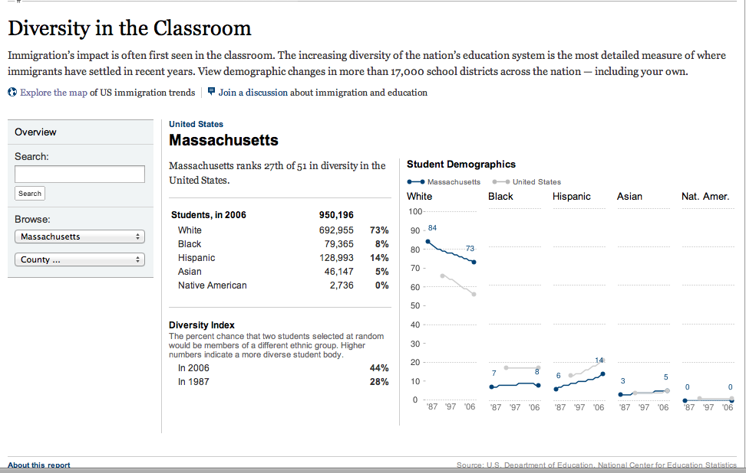
Diversity in the Classroom
http://projects.nytimes.com/immigration/enrollment

Slide 6
Why is this important?
English Language Learners (ELL) are also known as Limited English proficient students (LEP).
5.5 million ELL students in U.S. public schools speak more than 400 different languages.
80% of ELL students speak Spanish as first language.

Slide 7
Why is this important?
In 2014, 7.9% of enrolled students in MA were ELL up from 6.2% in 2010.
In 2014, 17.9% of enrolled students in MA were Hispanic, up from 14.% in 2010.
Between 2001 and 2010, ELL enrollment in MA increased by 27%.

Slide 8
ELL and Hispanic student underperformance
MA once again failed to close proficiency gap for ELL students (Massachusetts State Report Card).
Attrition rate for ELL students was 4.2%, 3.2% for Hispanic students and 2.3% for White students.
Out of school suspension rates for ELL students were 5.7%, 7.7% for Hispanic students and 2.4% for White students.
Drop out rates for ELL students were 14.9%, 14.4% for Hispanic students and 3.5% for White students.
Notes:
MCAS – www.doe.mass.edy/mcas/about1.html?faq=9

Slide 9
MCAS Scores
ELL students enrolled in their first year in a school are exempted from the language test.
ELL students may use approved bilingual dictionary.
In 2014, 4th grade ELA, 25% of ELL and 26% of Hispanic students scored proficient on the ELA part compared to 46% of their White peers.
In 2014, 23% of ELL students and 34% of Hispanic students scored proficient in 4th grade Math compared to 50% of their White peers.

Slide 10
Case Law and Statutory Review

Slide 11
Federal Statutes
Title VI of the Civil Rights Act of 1964 (“Title VI”) U.S.C. § 2000d, 34 C.F.R. pt. 100, and 28 C.F.R. § 42.104(b)(2);
Equal Educational Opportunities Act of 1974 (“EEOA”), 20 U.S.C. § 1703;
Individuals with Disabilities Education Act (“IDEA”) 20 U.S.C. § 1400 and 34 C.F.R. pt. 300;
Title III No Child Left Behind Act 20 U.S.C. §6842 et seq.;
ADA 126 USC § 12106 and Section 504 29 U.S.C. § 701 (for those who communicate through ASL).

Slide 12
Title VI of the Civil Rights Act of 1964
Prohibits discrimination based on race, color, or national origin.
Requires programs that educate children with limited English proficiency to be:
1. Based on a sound educational theory;
2. Adequately supported, with adequate and effective staff and resources, so that the program has a realistic chance of success; and
3. Periodically evaluated and, if necessary, revised.
Notes:
Federal law does not dictate the curriculum schools must use to teach English learners.

Slide 13
Equal Educational Opportunities Act of 1974 (EEOA)
Federal law requires states and school districts to provide an equal educational opportunity to students learning English.
“No State shall deny equal education opportunity to an individual on account of his or her race, color, sex, or national origin, by the failure by an educational agency to take appropriate action to overcome language barriers that impede equal participation by its students in instructional programs.” 20 U.S.C. § 1703(f).

Slide 14
Equal Educational Opportunities Act of 1974 (EEOA)
Means teaching academic content in the language students understand, while also teaching them English.
EEOA requires school districts to take “affirmative steps” to address language barriers so that students can participate meaningfully in the schools’ educational programs.
Supreme Court held that under EEOA courts can’t dictate form of bilingual education and costs in programming. Horne v. Flores, 557 U.S. 433 (2009).

Slide 15
Castañeda v. Pickard (5th District, 1981)
Court articulated a three-part test to determine whether language programs for English learners comply with the EEOA.
Other federal courts have used this three-part test since:
1. “Ascertain that a school system is pursuing a program informed by an educational theory recognized as sound by some experts in the field, or, at least deemed a legitimate experimental strategy...”
2. Determine “whether the programs and practices actually used by a school system are reasonably calculated to implement effectively the educational theory adopted by the school.”
3. Ensure that “after being employed for a period of time sufficient to give the plan a legitimate trial, [the plan] produce[s] results indicating that the language barriers confronting students are actually being overcome...”

Slide 16
Individuals with Disabilities Education Act (IDEA)
Requires States and schools to make a free and appropriate public education available to children with disabilities residing in the State in the least restrictive environment (LRE);
The multidisciplinary team must consider the language needs (not content-based) of ELLs when developing, reviewing or revising IEPs.

Slide 17
Individuals with Disabilities Education Act (IDEA)
Mandates parental involvement through a “Team meeting” process.
District “must take whatever action is necessary to ensure that the parent understands the proceedings of the IEP Team meeting, including arranging for an interpreter for parents with deafness or whose native language is other than English.” 34 CFR §300.322(e).

Slide 18
Individuals with Disabilities Education Act (IDEA)
Mandates procedures designed to ensure that the notices, records, or any other written materials are in the native language of the parents, unless it clearly is not feasible to do so. 20 USC §1400(b).
Evaluation and placement procedures must be conducted in the child’s native language, parents need to provide “informed consent.”

Slide 19
No Child Left Behind Act
Requires states to implement statewide accountability systems. Assessment results must be broken out by poverty, race, ethnicity, disability, and limited English proficiency to ensure that no group is left behind.
Gives states flexibility in defining the students who constitute the LEP (or ELL) subgroup.
Notes:
FLEXIBILITY-- (i.e. define narrowly as only those students receiving direct, daily LEP services or broadly to include both students receiving direct services and students being monitored)

Slide 20
No Child Left Behind Act
Title III appropriates funds to supplement services to ELL student.
In return, NCLB requires providing notice to parents about their child’s identification and services in a language parents can understand.
Recipient of funds must be engage in outreach activities of parents of ELL students. 20 U.S.C. § 7012(c),(e).

Slide 21
NCLB, Dept. of Education
DOE issued 2 new policies designed to help students who are new to the U.S. and to give states greater flexibility to meet the requirements of NCLB (optional and voluntary).
Allow LEP students, during their first year, to take the reading/language arts content assessment in addition to taking the English language proficiency assessment
For AYP calculations, states are allowed up to two years to include in the LEP subgroup former LEP students who have attained English proficiency.

Slide 22
Other DOE/DOJ Guidance
School districts must provide effective language assistance to limited English proficient parents, offer translated materials or a language interpreter.
“School districts should ensure that interpreters and translators have knowledge in both languages of any specialized terms or concepts to be used in the communication at issue, and are trained on the role of an interpreter and translator, the ethics of interpreting and translating, and the need to maintain confidentiality.” It is not sufficient for the staff merely to be bilingual.
January 2015 Fact Sheet. Found at: https://www2.ed.gov/about/offices/list/ocr/docs/dcl-factsheet-lep-parents-201501.pdf

Slide 23
ADA and Section 504
Section 504 only applies to entities that receive federal financial assistance.
Both prohibit disability discrimination by public entities in state and local government.
Must communicate effectively with people who have hearing, vision, or speech disabilities, unless doing so would fundamentally alter the nature of the service, or result in undue financial or administrative burden.

Slide 24
Lau v. Nichols 414 U.S. 563 (1974)
School districts have an affirmative duty to take steps to help limited-English proficient (LEP) students overcome language barriers and to ensure that they can participate meaningfully in the district's educational programs.
As a result, a school district would be in violation of Title VI if it denies access to its educational programs or services on the basis of language proficiency.
Notes:
Affirmed a 1970 OCR Guidance “Identification of Discrimination and Denial of Services on the Basis of National Origin” (May 25, 1970).

Slide 25
MA State Statutes
MGL 71A, 603 CMR 14.00 and 603 CMR 28.00
603 CMR 14.04- Provides for ELL students to learn English through a sheltered English immersion program for a max. of one school year.
Provides for waivers based on parent request under certain circumstances. Parent needs to apply by providing written informed consent. (MGL 71A (5)).

Slide 26
MA State Statutes
Kindergarten students can be placed in sheltered English immersion classrooms, mainstream classrooms with ELL assistance or, two-way bilingual classrooms. (MGL 71A(4)).
If 20 students or more in a grade level receive a waiver, then district must offer a bilingual or other language support program; if not, must allow student to transfer to a school within the district in which such a program is offered. (MGL71(5(a)).

Slide 27
MA State Statutes
603 CMR 28.00 - Special Education Statute
Communications shall be in both English and the primary language of the home, if other than English. Interpreters need to be fluent.
If unable to read in any language or are blind or deaf, communications shall be made orally in English or with the use of a foreign language interpreter, in Braille, in sign language, via TDD, or in writing, whichever is appropriate. 603 CMR 28.07 (8)

Slide 28
MA State Statutes
272 §§ 98 and 92A – MA Public Accommodation Laws
If blind or deaf, establishes use of Braille, sign language, or appropriate accommodation.
MA prohibits discrimination based on disability in “any place of public accommodation, resort, or amusement.”

Slide 29
Providing Culturally Competent Advocacy

Slide 30
Cultural Differences: High Context versus Low Context
Presented by the anthropologist Edward T. Hall in his 1976 book Beyond Culture..
Cultural differences may be mundane and subtle but cause great conflict.
One such difference is that of a high context culture versus a low context culture.

Slide 31
What is a low context culture?
Things are fully spelled out, made explicit
Considerable dependence on what is actually said or written
More responsibility is placed on the listener to keep up their knowledge base and remain plugged into informal networks.
Include: Anglos, Germanics and Scandinavians.
Not known for their ability to tolerate or understand diversity, and tend to be more insular. The explicitness with which they communicate can often cause offence and resentment.

Slide 32
What is a high context culture?
Communicators assume a great deal of commonality of knowledge and views, less is spelled out explicitly
Include: Japanese, Arabs and French.
Vulnerable to communication breakdowns when they assume more shared understanding than there really is.
High context cultures are strongly inclined to indirect methods of communication.

Slide 33
Cultural Differences in Schools
A person’s gender, age, position in society, level of acculturation, and individual preference can complicate communication even more.
EXAMPLE: eye contact.
Latin American and Asian cultures show respect by avoiding the glance of authority figures.
A teacher who’s unfamiliar with this cultural norm, however, might interpret the lack of eye contact as a sign of disrespect.
Yet a teacher who doesn’t know this could think the child was unmotivated or inattentive.

Slide 34
Match nonverbal and verbal messages
To create a positive environment for communication, your nonverbal message must closely match your verbal message.
Recognize your own expectations about nonverbal communication, and then find ways to learn about those of individuals and other cultures.
Nonverbal messages have a powerful impact on what’s communicated.

Slide 35
Attorneys should consider:
Getting to know the community you are representing: Accurate knowledge about the diversity of clients, their needs and preferences for receiving information, will guide communication practices.
Communicating effectively: Consider clients’ cultural backgrounds and preferred communication styles.
Providing materials in appropriate languages and offer professional interpreting services

Slide 36
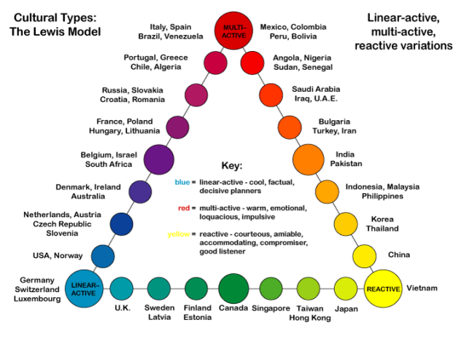
School Staff should:
Cultivate a culture of respect, caring and inclusion of difference amongst the whole school community for the purpose of supporting positive mental health and reducing school-based risk factors for children.

Slide 37
Questions and Resources
U.S. Department of Education’s Office for Civil Rights (OCR) at www.ed.gov/ocr or contact OCR at (800) 421-3481 (TDD: 800-877-8339) or at ocr@ed.gov.
For more information about filing a complaint, visit www.ed.gov/ocr/complaintintro.html.
U.S. Department of Justice’s Civil Rights Division at www.justice.gov/crt/about/edu/ or contact DOJ at (877) 292-3804 or at education@usdoj.gov.
For more information about filing a complaint, visit www.justice.gov/crt/complaint/#three.
For more information about school districts’ obligations to English learner students and limited English proficient parents, additional OCR guidance is available at http://www2.ed.gov/about/offices/list/ocr/ellresources.html.

