Slide 1
Basic Benefit Training: Immigrants’ eligibility for health benefits
Vicky Pulos, MLRI
vpulos@mlri.org
March 19, 2025

Slide 2
What we’ll cover
Health benefits available to
Undocumented immigrants
Eligible immigrants
Red flags that someone is in the wrong coverage
Resources
Eligibility rules and policies
MassHealth training materials
Where to go for help

Slide 3
Key takeaways
There is one common application for all the health programs run by MassHealth or the Health Connector
There are health benefits of some kind available for all low-income individuals living in MA regardless of immigration status
There are comprehensive health benefits for pregnant people and for all US citizens or“eligible immigrants.”
For more complex cases, get state-wide help from the Health Care for All Helpline & Navigators
Notes:
Resource list for assisters on last pages

Slide 4
Health Benefits
Comprehensive benefits for US
citizens & eligible immigrants
MassHealth Standard, CarePlus, CommonHealth & Family Assistance
ConnectorCare
Safety net benefits with no citizenship/immigration requirements
Health Safety Net Program (HSN)
Children’s Medical Security Program (CMSP)
MassHealth Limited
MassHealth Standard for Pregnant People + 12 months post-partum
Notes:
. Info in online materials: MassHealth income limits; Table comparing benefits in MassHealth programs; ConnectorCare overview

Slide 5
Safety Net Benefits
MassHealth Limited:
Emergency services only
Examples: Ambulance, ER, labor & delivery, dialysis, treatment for COVID-19
Plus Health Safety Net (HSN)
Children’s Medical Security Plan (CMSP):
Primary and preventive care only
Plus Health Safety Net (HSN) if 300% FPL or less
Health Safety Net (HSN):
Services billed by acute hospitals and community health centers (CHCs)
Excludes services provided at hospital or CHCs but billed by other providers
0-150% FPL full HSN; 150-300% FPL partial HSN with a deductible
MassHealth Standard during Pregnancy & 12 months post-partum
Notes:
Available to undocumented but not just for undocumented (e.g. Nonqualified lawfully present adults may be on ConnectorCare plus Limited )
Flyer in Eng & Sp & Port in online materials describing safety net benefits & how to apply
April 2022 increased from 60 days to 12 months post-partum

Slide 6
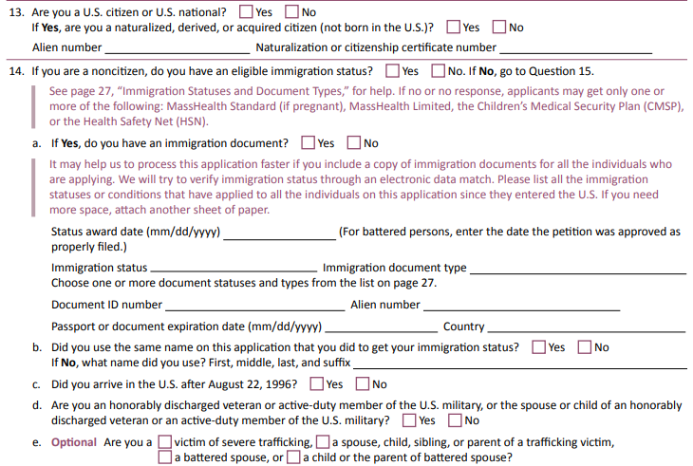

Slide 7
SSN-applicants must answer

Slide 8
Is it safe for undocumented to apply?
From page 8 of Member Booklet(March 2025):
What non U.S. citizens need to know about applying for MassHealth Limited, MassHealth coverage for pregnant women, CMSP, and the Health Safety Net
Applications and the information on them will be kept confidential. This means that:
◆ we will not send names and addresses to immigration enforcement officials
Notes:
KCG Link to applications & member book in online materials

Slide 9
Privacy Protections
State & Federal law limit MassHealth from disclosing information except for purposes of administering the program:
establishing eligibility, determining the amount of medical assistance, providing services or
conducting or assisting an investigation, prosecution or civil or criminal proceeding related to administration of the state Medicaid plan.
The SAVE data match with USCIS
Is used to verify document information supplied by an “eligible immigrant” on the application
By federal law, it cannot be used for purposes of immigration enforcement

Slide 10
MassHealth coverage for pregnant people
Eligible for MassHealth Standard regardless of
immigration status during pregnancy & 12 months post-partum*
-Report pregnancy ASAP
-Pregnancy can be during 3 month retro period
Notes:
vp
MH will be extending post-partum to 12 months when new option available April 1.

Slide 11
Exercise #1
Marie was on MassHealth Limited before she became pregnant
She was still on Limited when she gave birth
30 days after her hospital discharge, she goes to a Health Center for care for herself & her newborn.
Can she qualify for Standard?
See 130 CMR 502.006(B)
Notes:
502.006(B) –change in circ for pregnant woman or child under 19 can take effect up to 3 mo prior to date of eligibility determination

Slide 12
Who is an “eligible immigrant”
“Eligible”under public benefit laws ≠ “lawful status” under immigration laws
Some people are “eligible” who-
have not yet applied for a lawful status like certain Trafficking Victims
are in removal like certain Cuban/Haitian Entrants
have applied for lawful status but not yet gotten it, like some Special Immigrant Juveniles
have lawful status but do not have work authorization or SSNs, like most foreign students & dependents

Slide 13
Key Questions to Ask Clients
1. Current immigration status?
2. Does it expire and when?
3. Prior status before now?
4. What country are they from?
5. How long in the US?
6. What immigration documents do they have?

Slide 14
Terms used in Health Programs
Connector Terms | MassHealth Terms | Eligible Immigration Status?
Lawfully Present * | Lawfully Present and Qualified | Yes
 | Lawfully Present and Qualified Barred
 | Lawfully Present but not Qualified or Qualified Barred
Not Lawfully Present | PRUCOL (not Qualified, not Lawfully Present) | Yes, but only for MassHealth
 | Other (including undocumented) | No, but Safety Net Benefits available
Notes:
Connector –ACA 2010
MH- PRUCOL pre 1996, Qualified 1996,, State-funded coverage since 1996, CHIP-Pregnant people 1997, LP 2009 for children
* Def of LP for Connector now includes some people who are not LP

Slide 15
Lawfully present immigrants for MH
Qualified
Non-Qualified
Lawful permanent resident (LPR/Green Card holder)*
Person paroled into the U.S. for at least one year*
Battered spouse, child, or parent*
Asylee
Refugee
Victim of trafficking and his or her spouse, child, sibling, or parent
Person granted Withholding of Removal
American Indian tribal members born outside US
Cuban/Haitian entrant
Afghan or Iraqi Special Immigrants
Afghan or Ukrainian Humanitarian Parolees
Certain Amerasians (from Vietnam)
*May be subject to 5-year bar
Paroled into the US for less than one year
Granted withholding or Removal under CAT
Valid non-immigrant status
Temporary Protected Status (TPS)
Deferred Enforced Departure (DED)
Deferred Action Status (except DACA; they are PRUCOL)
Applicant for:
Special Immigrant Juvenile Status;
Adjustment to LPR Status with an approved visa petition;
Asylum or Withholding of Removal with work permit (EAD) or if under age 14 pending for at least 180 days:
Individuals with employment authorization under 8 CFR 274a.12(c)
Lawful temporary resident granted under legalization program (8 USC 1160 or 1255a)
Granted an administrative stay of removal by the DHS
Notes:
We’ll come back to this for exercises
DACA-ACA rule eff in Nov 2024 now adds some categories to LP for the Connector (Mktplace) but not for MassHealth (Medicaid) 42 CFR 155.20 (eff Nov 1, 2024) Enjoined in 19 states but not in MA

Slide 16
Lawfully Present Children & Young Adults
Children under 19 eligible for MH Standard, Family Assistance or CommonHealth
No 5 year bar
Young Adults 19-21 with income 150% FPL or less(YA) eligible for Standard
Over 150% FPL treated like other adults not YA
PRUCOL children & YA: State-funded Standard or CommonHealth
Notes:
VP

Slide 17
Lawfully present & Connector
Only Lawfully Present non-citizens are eligible to obtain insurance through Connector
NQLP with income under 133% FPL will be eligible for both ConnectorCare AND MassHealth Limited
PRUCOL are not eligible for Connector, but are eligible for State-funded MassHealth Family Assistance if 300% FPL or less
ConnectorCare pilot in 2025 goes up to 500% FPL
2025 changes in ConnectorCare affecting DACA
Notes:
https://www.govinfo.gov/content/pkg/FR-2024-05-08/pdf/2024-09661.pdf
NEW: DACA with income 301-500% FPL (too high for MH as PRUCOL) are now eligible for ConnectorCare (45 CFR 155.20 (eff 11.1.2024)
Feb 2025, HHS Proposed rule to amend LP definition to once more exclude DACA.

Slide 18
Qualified Barred: 5-year bar
5 year bar applies to Lawful Permanent Residents (LPR), Paroled or Battered Immigrants unless--
In status above for 5 or more years
Previously in a never-barred status (e.g. refugee who becomes LPR)
LPR exempt from bar (e.g.Veterans, Iraqi/Afghan SI)
Arrived in US prior to 8/22/96 & continuously present until getting status above
Notes:
We’ll come back to this

Slide 19
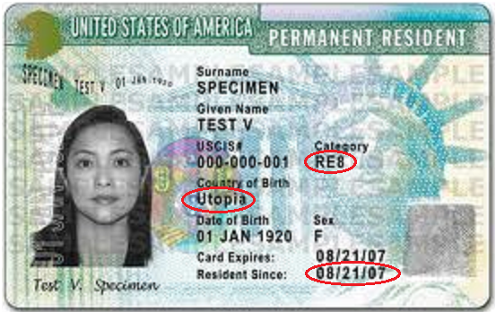
Lawful Permanent Resident Card
Does code show status not subject to 5 yr bar?
If country is Cuba, Haiti, Iraq, Afghanistan, Vietnam (Amerasian), Canada (tribal member) –does exception to bar apply?
Is date 5 or more years ago?
Notes:
Slide 10 on 5-year bar. RE8 Refugee who adjusted status to LPR –no 5 year bar

Slide 20
Exercise #2
Mrs. Gutierrez is 60 and has been in US for 24 years with TPS
Is she Qualified?
What if it is 3 years later and she has gotten a green card?
Is she Qualified now?
Notes:
No. TPS. Nonqualified LP and eligible for ConnectorCare
Not yet. Now Qualified but still barred. QAB. Still CC

Slide 21
PRUCOL in MassHealth
PRUCOL is a public benefits term not an immigration status
State-funded category for people in U.S. “under color of law” but not “Lawfully Present” including-
Deferred Action Childhood Arrivals (DACA) aka Dreamers *
Applicants for asylum/withdholding who don’t have work permits yet*
Others not on Lawfully Present list but known to USCIS & not contemplated for removal
Feb 2022 Eligibility Ops Memo with improved info to identify & verify PRUCOL
Notes:
VP
Not an immigration status. Defined by MassHealth. Benefits for PRUCOL are all state-funded. Not eligible to use Health Connector.
Once Asylum applicants get work permit (or if under 14 has had application pending for more than 180 days)—they will be LP

Slide 22
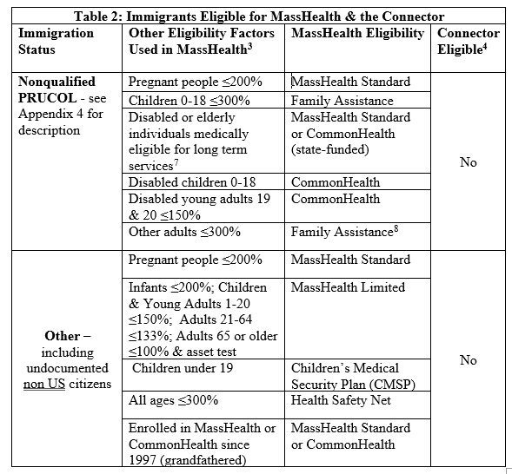
Understanding Non-citizens’ eligibility for health coverage, Table 2 (in materials)
Notes:
We’ll come back to this for exercises

Slide 23
Application Tips
List preferred language
Notices are now being sent in 5 non-English languages: Spanish, Portuguese, Haitian-Creole, Chinese & Vietnamese
If no stable housing
Check homeless box and supply a mailing address
Use Authorized Designation Form if there is a trusted person to act for you & get copies of notices
Use self-attestation forms if no other proof for-
Income (Aff. of zero income, Attestation to verify income, Verification of self-employment income)
Residence in Massachusetts

Slide 24
What proof is needed?
Health Safety Net –proof of identity is required
Eligible immigration status
1st agency attempts to verify via SAVE data match using document ##s
If no match, applicant gets 90 days to submit documentary proof
Will be eligible based on declared status during this ”reasonable opportunity period”
May request an additional 90 day period to submit proof (for cause)

Slide 25
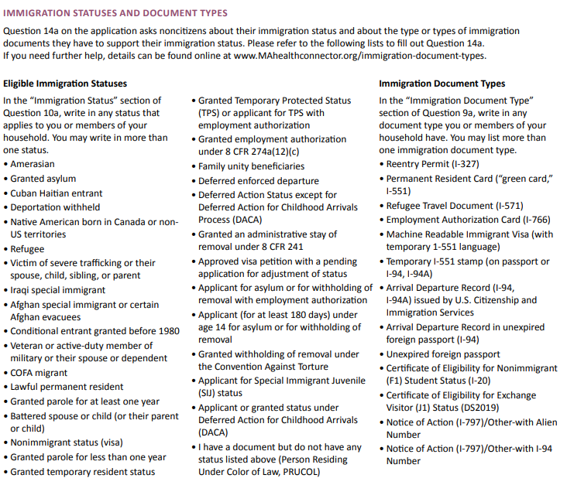

Slide 26
Cuban-Haitian Entrants (CHE)
A Qualified Lawfully Present category for Cubans & Haitians who are:
Paroled into the US after 1980 even if parole has expired,
Applicants for asylum even if no work permit yet,
In removal proceedings so long as there is no final, non-appealable order of removal, or
LPRs granted under certain special laws like Cuban Adjustment Act (CAA) or HRIFA
Haitian TPS is not CHE but a CHE can also have TPS
For example, Haitian paroled into US who later obtains TPS is still CHE
Eligibility Operations Memo 22-03, Eligibility Rules for Cuban and Haitian Entrants (Feb. 2022)

Slide 27
Where mistakes can occur
Incorrect info is supplied on application
Correct document info is supplied but not verified & incorrect status is selected at application for reasonable opportunity period
Correct paper document is submitted but MassHealth incorrectly rejects it
Correct info is supplied but there is a system processing error

Slide 28
Watch out for duplicate applications
Duplicate applications can occur where the same person is in the MassHealth system with different names & MH ID#s and sometimes different coverage
Red flag is a family receiving TAFDC or EAEDC who providers think have Limited
TAFDC = Standard. EAEDC =Standard/CarePlus/Family Assistance
Check if names are spelled differently or DOB is different on different documents to help provider find correct coverage in MMIS/EVS
DTA can supply temporary MH card with MH ID #

Slide 29
Exercise #3
Nathalie is a 26 year old Haitian with humanitarian parole for 2 years.
What is her eligibility status?
Natalie obtains TPS
What is her eligibility status?
What if she loses her TPS?
Notes:
CHE. No 5 year bar. Qualified. CarePlus or ConnectorCare
CHE & TPS. Qualified based on CHE.

Slide 30
When Limited is a red flag
If one of these people has MassHealth Limited, you know there is a mistake
Qualified immigrant e.g. LPR for 5 yrs; Refugee/Asylee; Cuban-Haitian Entrant
Lawfully present child under 19
Lawfully present young adult (19-20) income 150% FPL or less
Person who is pregnant or post-partum
Person on SSI, TAFDC, or EAEDC
If lawfully present (nonqualified) adults 21+ have Limited, no mistake if they ALSO have ConnectorCare

Slide 31
Elderly or disabled adults
Eligible for -
MassHealth Standard, Medicare Savings Program, or CommonHealth if Qualified
State-funded Family Assistance if NQLP or PRUCOL & income is ≤ 100%: disabled or elderly*
Path to state-funded long-term care
Notes:
VP
Family Assistance if Lawfully Present; may also be eligible for the Health Connector if income over 100% FPL
FA if PRUCOL because not eligible for Health Connector

Slide 32
State-funded long-term care
Since Nov, 2021, disabled people (of any age) who are not Qualified but Lawfully Present or PRUCOL & need long term care or PCA are eligible for state-funded MassHealth Standard if they-
Meet a Nursing Home level of care, or
Need help with at least 2 ADLs from a Personal Care Attendant (PCA)
State-funded MassHealth Standard covers not just Nursing Homes & PCAs but other LTSS too e.g. Adult Day Health
July 2023 Eligibility Operations Memo
In FY 2026 MassHealth may be restricting this benefit to those who need a nursing home level of care & were recently discharged from a hospital
Notes:
Plus usual MH rules apply e.g. person under 65 must also be found disabled to qualify for LT NF care & complete LTC Supp

Slide 33
Immigrants’ eligibility for Medicare
A non-citizen who has met the earnings test for Social Security Insurance-Based benefits
Is eligible for Medicare if lawfully present & age 65 or over or on SSDI for 24 months
A non-citizen who has not met the earnings test
Is eligible for Medicare at age 65 if a lawful permanent resident & continuously residing in US for the 5 years prior to applying for Medicare
Will have to pay a premium for Part A (usually free) as well as Parts B and D
See, Justice in Aging’s Issue Brief: Older Adult Immigrants and Medicare (Aug 2024).

Slide 34
Trouble shooting tips
Get copy of client’s immigration documents
Use tools in materials to figure out eligible benefits status: using MassHealth terms
Ask MassHealth/Connector what computer shows is client’s immigration eligibility status
Find out what information was submitted to MassHealth/Connector & how it was verified
Get info corrected informally or appeal
Notes:
KCG

Slide 35
Where to go for help
Help applying, renewing, signing up for a plan from the HCFA Helpline, the Mayor’s Health Line and other certified application counselors or Navigator organizations.
Enrollment Assister Search - organizations near you.
Navigators - statewide
Health Care for All Helpline - statewide
Legal services from GBLS, HLA and other legal aid masslrf.org/en/home
MassHealth Enrollment Centers: appointment scheduler
MassHealth Customer Service 800-841-2900
Immigration help referral list | Massachusetts Legal Help

Slide 36
Resources in materials & online
MLRI, Health benefit available without regard to immigration status (English, Spanish & Portuguese)
MLRI, Eligibility of non-citizens for health coverage from MassHealth and the Health Connector (2025)
MassHealth and Health Connector, Immigration Document Types-description of documents, how to find codes from different documents and photos of sample documents
Materials related to state-funded Standard for certain elderly or disabled noncitizens
MIRA Coalition website
National Immigration Law Center website

