Slide 1
ConnectorCare Eligibility & Enrollment
MLRI Basic Benefit Training
February 4, 2025
Hannah Frigand, Senior Director of Education & Enrollment Services
Health Care For All hfrigand@hcfama.org

Slide 2
What is ConnectorCare?
Insurance through private health plans with the government helping pay for much of the costs of coverage (e.g. premiums and cost-sharing)
You can only get it from the Massachusetts Health Connector

Slide 3
Health Connector
The Massachusetts Health insurance marketplace determines eligibility for state subsidized and unsubsidized insurance for the under 65 population living in the community.
Qualified health plans offered through the Health Connector go through an annual seal of approval process after Division of Insurance rate review.
Overseen by a board

Slide 4
Role of Health Connector
Health insurance “marketplace” for private Qualified Health Plans
Determines who qualifies for state subsidized and unsubsidized insurance for the under 65 population living in the community.
Sets rules for state individual mandate that requires Massachusetts residents over 18 to have creditable health insurance
Notes:
The Health Connector was created under Chapter 58 MA health reform and was modified after the ACA passed
Qualified Health Plan is a term coined under the ACA.
Health Connector goes through “Seal of Approval” process each year to determine which plans they will approve for sale through the Health Connector
People can still purchase plans outside the Health Connector/directly through the carrier, but they will not be able to get any subsidies
Individual mandate = state requirement for adults to have health insurance, or incur a tax penalty. Started in MA in 2007. We’ve also had the individual mandate through the ACA through 2018. The federal administration effectively repealed it for tax years starting in 2019 by reducing the penalty to $0. BUT, the MA individual mandate remains.
Connector sets rules for minimum creditable coverage (what type of coverage you need to meet the mandate) and affordability standards (if no affordable option available to you, exempt from mandate).

Slide 5
Individual Mandate
Massachusetts residents over 18 years old can be penalized on their state taxes if uninsured/underinsured.
Coverage must meet Minimum Creditable Coverage standards.
Some insurance automatically meets MCC criteria.
Health Connector sets an affordability schedule each year.

Slide 6
Health Connector Locations
Boston Walk-in Center located at 133 Portland Street, Boston
Springfield Walk-in Center is located at 88 Industrial Avenue, Suite D, Springfield
Worcester Walk-in Center is located at 146 Main Street, Worcester
Customer Service Phone Number: 1-877-MA-ENROLL (1-877-623-6765)
Website: www.mahealthconnector.org

Slide 7
Health Connector Offerings
Individual Coverage
Subsidized health coverage
ConnectorCare for those with income of 500% FPL or less
Authorized through 2025: additional tax credits for eligible Health Connector members when coverage would cost over 8.5% of income
Unsubsidized health plans
Stand-alone dental plans
Health Connector for Business
Health & dental plans for small employers who want to offer insurance to their employees
Notes:
Health Connector sells health plans to individuals/families and small businesses (Connector focuses on very small groups)
I will focus on ConnectorCare during this presentation; it is by far the largest program that the Health Connector runs.
To give you an idea of enrollment. As of December 2018, total non-group enrollment in Health Connector plans was 261,537. Of those,
199,246 were enrolled in ConnectorCare (<300% FPL)
62,291 were in unsubsidized or APTC-only plans (>300% FPL)
81,457 enrolled in separate dental plan
Small business enrollment was:
5,689 people for medical plan (1305 for dental)
1,234 businesses (222 groups for dental)

Slide 8
Health Connector Eligibility Factors
Criteria for shopping on the Health Connector:
Immigration status – must be "lawfully present"
MA residency
Not be sentenced and in jail or prison
Factors used for qualifying for subsidized coverage:
Tax filing status
If married must file jointly
Tax household
Annual income
No affordable health insurance access:
Work insurance must be unaffordable, or not meet minimum value.
Not be enrolled in Medicare or VA
Not eligible for MassHealth other than MassHealth Limited

Slide 9
Why tax filing matters
The assistance for premium costs comes from Advance Premium Tax Credits (APTC) based on income eligibility
Based on estimated annual tax income for the year
Paid in advance by US Treasury directly to insurance company each month
Must file taxes for year in which APTC received
Must “reconcile” advanced credit based on estimated income with actual credit due based on actual income on tax return
Not eligible for APTCs in 2025 if failed to reconcile for two consecutive years in which APTCs were received
Notes:
Now I’m going to focus on the “TAX” aspect of APTCs
APTC reconciliation:
If your annual income is higher than anticipated, you may need to pay back APTCs
If your annual income is lower than anticipated, you may get additional tax credits back

Slide 10
Financial eligibility for APTC
Health Connector coverage would cost over 8.5% for a benchmark plan
Income 500% FPL or less for ConnectorCare (affordable coverage)
Income at least 100% FPL unless
Lawfully present non-citizen is not eligible for MassHealth due to immigration status
Even though income under filing threshold, APTC creates tax filing obligation

Slide 11
Modified Adjusted Gross Income
Household includes tax filers & tax dependents
Income is expected annual “adjusted gross income” on federal tax return plus
Nontaxable Social Security Income
Nontaxable Interest Income
Nontaxable Foreign Income
Tax dependents’ income doesn’t count unless high enough to require filing a separate return
Earnings over $14,600 in 2024 require a return
Unearned income over $1,300 in 2024 require a return (nontaxable Social Security & child support don’t count)
Notes:
Lowest cost plan for the Connector to subsidize plan = lowest cost plan for consumer

Slide 12
No other Insurance
Not eligible for Medicaid/MassHealth (except MassHealth Limited) or enrolled in Medicare Part A
Eligible if an applicant would need to pay for Medicare Part A & not enrolled in it
Not eligible for affordable Employer-Sponsored insurance
“Affordable” ESI means that your plan:
Costs less than 9.02% (2025) of family income for the employee contribution for either individual or family plan as applicable

Slide 13
ConnectorCare Expansion
Pilot program passed through the state budget for two years
As of 2024, eligibility increased from 300% to 500% FPL
For an individual, that means going from a $45,000 cutoff to a $75,000 cutoff.
This is the largest expansion of coverage in Massachusetts since the 2006 Massachusetts health reform law!

Slide 14
ConnectorCare
APTCs & added state-funded subsidies to keep costs low
No deductibles
Plans with options for no premium if income under 150% FPL
Copays vary by income level with 3 income tiers
Family income ≤ 500% FPL
As of 2024, all carriers offering insurance through the Health Connector are participating in ConnectorCare
Notes:
So, now that we have the basics, on to specific eligibility standards for ConnectorCare

Slide 15
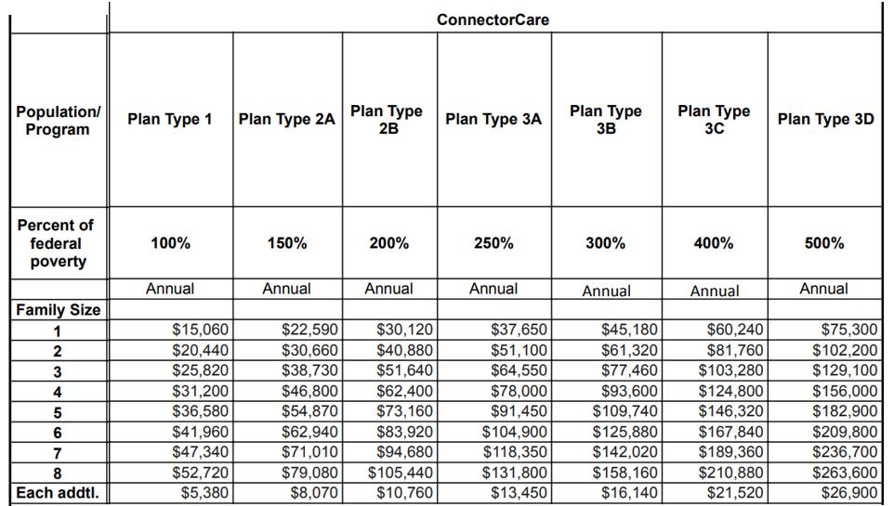
Federal Poverty Level Guide for ConnectorCare

Slide 16
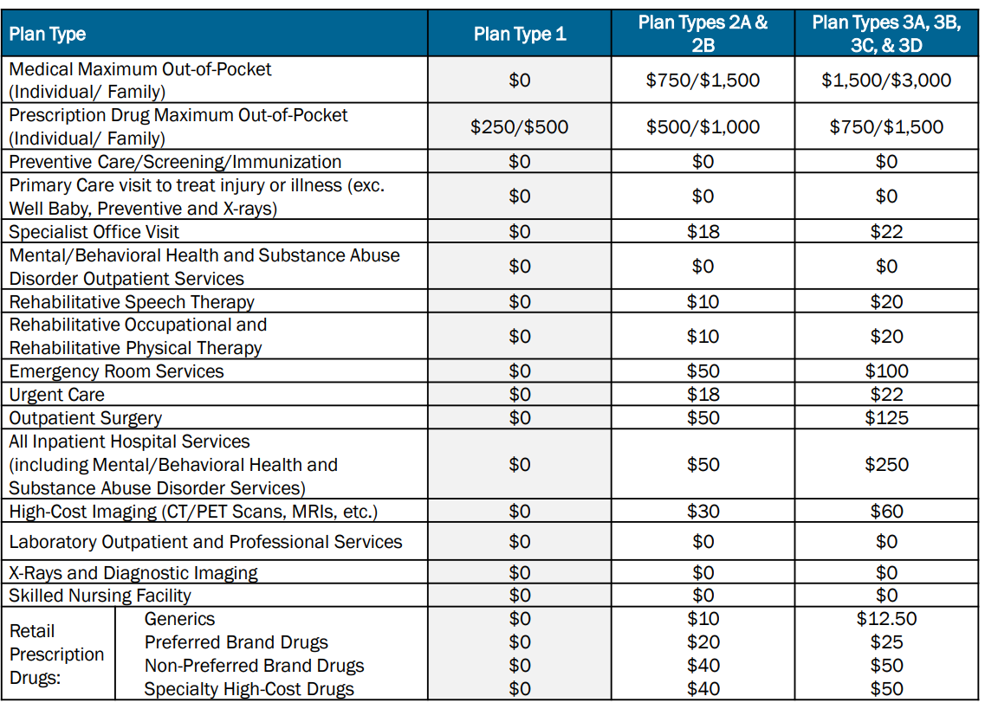
ConnectorCare Cost Sharing
ConnectorCare benchmark lowest premiums for 2025:
Type 1: $0
Type 2: $0
Type 2B: $51
Type 3A: $99
Type 3B: $147
Type 3C: $226
Type 3D: $264

Slide 17
Plan Selection and Premium Payments
Must affirmatively select a plan to enroll
Unless eligible for a zero dollar plan and opt to be auto-enrolled via application
Higher premium for some ConnectorCare HMO choices based on provider networks, but benefits the same
Deadlines to enroll & pay first month’s premium (if there is a premium)
by the 23rd of the month for coverage effective the 1st of the next month
after the 23rd, coverage not until the 1st of the following month
Notes:
This is for all individual/family coverage received through the Health Connector, not just ConnectorCare
If a plan is selected to start for a certain month and then they family does not make a payment they will have to re-select the plan selection for the following month to be effectuated with the payment
People can pay online, through self-service over the phone, or through the mail.
People can set-up recurring payments.

Slide 18
Open Enrollment
Only time individuals & families can enroll in Health Connector plan or change plans without a “qualifying event”
Open Enrollment for 2025 coverage ran from November 1, 2024 - January 23, 2025
After Open Enrollment has ended people cannot enroll for 2025 without a “qualifying event”
Qualifying event (QE) allows for “special enrollment period” (SEP)
Notes:
Open enrollment actually applies to individuals and families purchasing private insurance both through the Health Connector and outside the Health Connector (directly through a carrier)
People who would qualify for ConnectorCare, MassHealth, HSN are not limited to the Open Enrollment period

Slide 19
ConnectorCare Qualifying Event
Being newly eligible for ConnectorCare is a Qualifying Event
Applies automatically if this is first time you have qualified for ConnectorCare
If previously eligible for ConnectorCare & failed to enroll, unable to enroll until next open enrollment unless some other Qualifying Event occurs
Qualifying at a different income level can create a Special Enrollment Period
Notes:
Enrolled and lost coverage – maybe due to ESI becoming available, but then losing ESI and become ConnectorCare eligible again, for example
Or would now qualify for a different tier

Slide 20
Health Connector Special Enrollment Period
A person has 60 days from the date of a qualifying life event to enroll in a new health plan.
Examples:
Marriage/birth/adoption
Loss of job
Moving to Massachusetts
*If the applicant does not have a qualifying event they can try to obtain a waiver from the Office of Patient Protection to purchase insurance outside of Open Enrollment

Slide 21
Eligible but Unable to Enroll
Can apply at any time, but if it is outside of Open Enrollment and…
You are not newly eligible for ConnectorCare &
You don’t claim any other Qualifying Event
Decision will say you are eligible but not able to enroll
Need to claim Qualifying Event or ask for waiver through Office of Patient and Protection to enroll
Notes:
QE = Qualifying Event
Decision = decision on mahealthconnector.org application/enrollment system
More on OPP (Office of Patient Protection) in a bit

Slide 22
Helping Eligible not able to Enroll
Must identify Qualifying Event
Examples of QE for those eligible for ConnectorCare who did not enroll by deadline:
Mistakenly enrolled or did not enroll in a Health Connector health or dental plan due to an error, misrepresentation, or inaction on the part of the Health Connector or an enrollment assister
Good cause waiver available from Office for Patient Protection (OPP)
See materials online for more on Qualifying Events & Special Enrollment Periods
Notes:
QE = Qualifying Event
Decision = decision on mahealthconnector.org application/enrollment system
More on OPP (Office of Patient Protection) in a bit

Slide 23
Health Safety Net & ConnectorCare
People who are eligible for ConnectorCare under 300% FPL are also eligible for time-limited Health Safety Net (HSN)
HSN eligibility ends 90 days from date of eligibility notice
After 90 days, people qualify for HSN dental only
People eligible for ConnectorCare that do not enroll in a health plan still lose HSN after 90 days
Watch out for erroneous approval of ConnectorCare for immigrants that do not meet lawfully present guidelines
Notes:
QE = Qualifying Event

Slide 24
Newborn to Parent on ConnectorCare
Having a newborn is a qualifying event BUT
If family income is ≤300% FPL & newborn is eligible for MassHealth, baby will not be eligible for ConnectorCare
Newborn will not automatically get MassHealth unless mother had MassHealth Limited + ConnectorCare
Otherwise, newborn’s MassHealth coverage goes back 10 days prior to report of birth automatically but can request up to 3 months retroactive coverage
Report Birth ASAP!
Notes:
Recently updated Notice of Birth form is able to be completed for parent on ConnectorCare to add baby correctly to coverage. This is brand new in the last month so we still advise that the parent verify that their baby has been added. Report birth to Connector/update application

Slide 25
Non-Payment of Premiums
90-day grace period, but:
If all premiums owed are not paid within 90 days, coverage is terminated retroactively to the first unpaid month
Health Connector has process to apply for premium hardship waivers for ConnectorCare members only
Request form through Customer Service
Grounds include:
Homeless
Shut-off notice
Significant, unexpected increase in essential expenses (e.g. due to domestic violence, death of spouse; new caretaking responsibilities; household/personal damage cause by fire, flood, natural disaster)
Filed for bankruptcy

Slide 26
Key Differences from MassHealth
Differences in MAGI income calculation & household rules
Higher upper income limit with premiums & copays varying by income level
Different immigrant eligibility rules for adults
E.g. No 5 year bar for adult green card holders, must be lawfully present
Tax filing requirement
Requirement of no other coverage
Most members must take action to enroll
May be eligible but unable to enroll in some situations
No dental, no non-emergency medical transportation, no coverage for eyeglasses
Notes:
There are some key differences in eligibility for Connector coverage vs. MassHealth, including…
MAGI = Modified Adjusted Gross Income (Vicky is the expert on this) – adjusted gross income with additional deductions
Premium differences between ConnectorCare plans where with MassHealth you either have a premium or not and there is no difference in premium based on plan selection

Slide 27
Troubleshooting
Refer clients to enrollment assisters - they are trained to help
Call Connector Customer Service
Escalate to Health Connector Ombudsman
Appeal Connector decisions to Connector Appeals Unit
Information included with notice of decision
Have 60 days to file
Appeal health plan decisions:
1st to plan itself
If unresolved, then to Office of Patient Protection (same process as commercially insured)

Slide 28
Watch this Space
ConnectorCare expansion:
Currently going through calendar year 2025. Needs authorization to extend the pilot.
Increased tax credits from federal government through IRA will sunset at the end of 2025 unless congress extends them.
DACA recipients now eligible for Connector coverage:
Biden administration recently extended eligibility for marketplace coverage (including APTCs) to DACA recipients.
Lawsuits have paused this in the 19 states that sued the government to stop this (not Massachusetts). This court case and new administration may impact DACA recipients' ability to get marketplace coverage in the states that have been able to move ahead.

Slide 29
Thank you!
Any questions?

